Slide 1
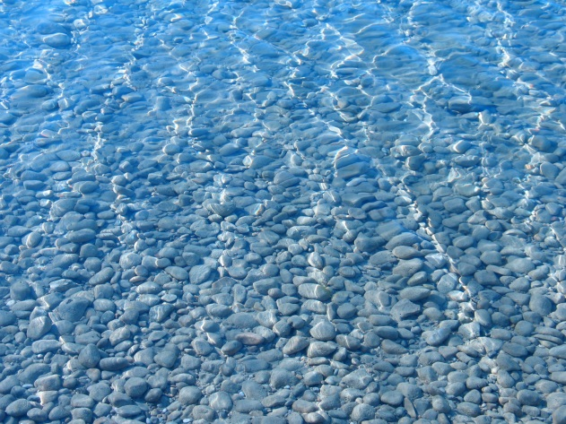
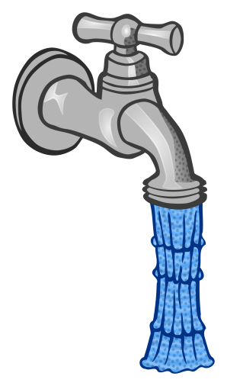
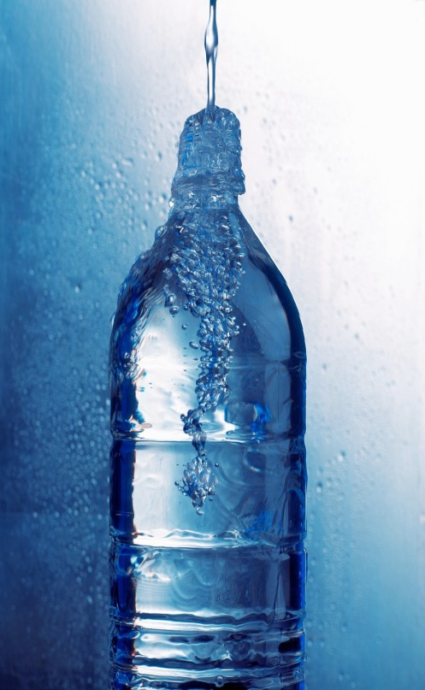
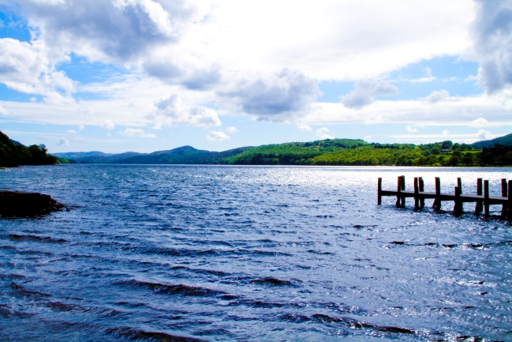
Water in the World
Year 7 - Term 3
2017

Slide 2
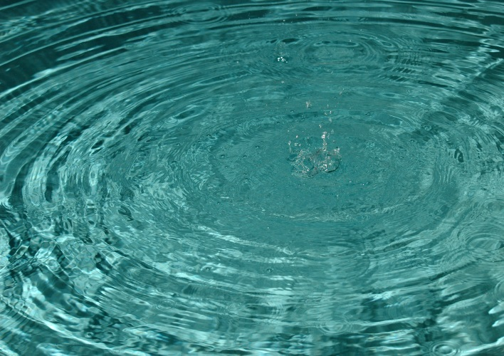
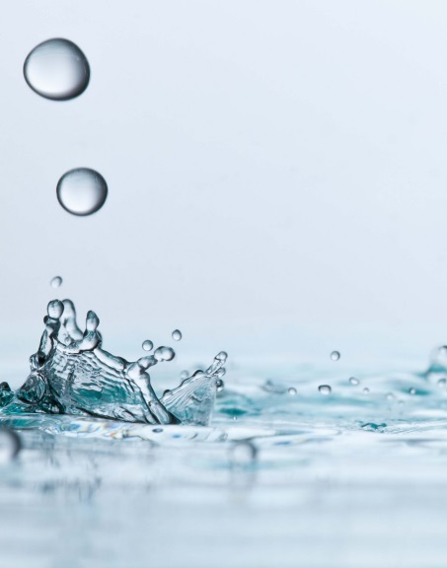
Introduction
This term we will be looking at water, how we use it and why its valuable to us.
- We will develop your ideas about and understanding of the environment.
- We look at how different people value the environment and water
Notes:
Task – Card Sort

Slide 3
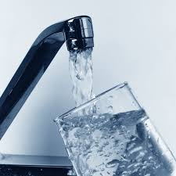
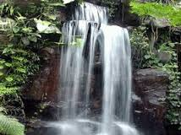
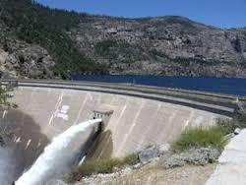
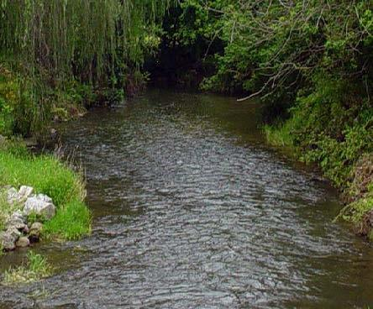
Brainstorm on Water!
Where do we find water? List as many places you can think of where we find water.
We will then construct a mind map of all of our ideas.

Slide 4
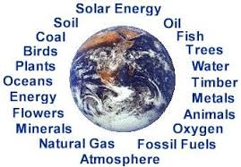
Natural Resources
A natural resource is any kind of substance in its natural form which is needed and wanted by humans.
Notes:
What is a natural Resource?
The most common categories of natural resources are minerals (such as gold and tin) and energy resources (such as coal and oil).
The air, forests and oceans can also be classified as natural resources.
Natural resources change in value over time, depending on what a society most needs or considers most valuable.

Slide 5

Renewable or Non-Renewable?
The various types of natural resources are often separated into renewable and non-renewable resources.
Notes:
How do we categorise them?

Slide 6
Renewable
Usually living resources as they can reproduce or re stock themselves
They are part of a cycle that allows them to be reused.
Only exist if they are not being used faster then they can replenish themselves.
Can include ground water, rivers, soil and fish

Slide 7
Non-Renewable
Cannot be re-produced or re-grown and are therefore in limited supply
Coal is considered a non-renewable resource. It is constantly being formed but too slowly to keep up with demand.
Other examples include oil, minerals and plants that become extinct

Slide 8
Continuous Resources
These resources will always exist
They will not run out
They include solar radiation (the sun), wind, tides, air, waves and water (not all water)

Slide 9
Non – Continuous
These resources may not exist in the future
The availability depends on human activity and could run out in the future
For example drawing water from a lake and leaving it dry).

Slide 10
Your Task - think/write/share
Think about how you use water each day.
When do you use water? At what time of the day?
What do you use it for?
How much water do you think you use? (how many litres of water?)
Why is water so important for humans?

Slide 11
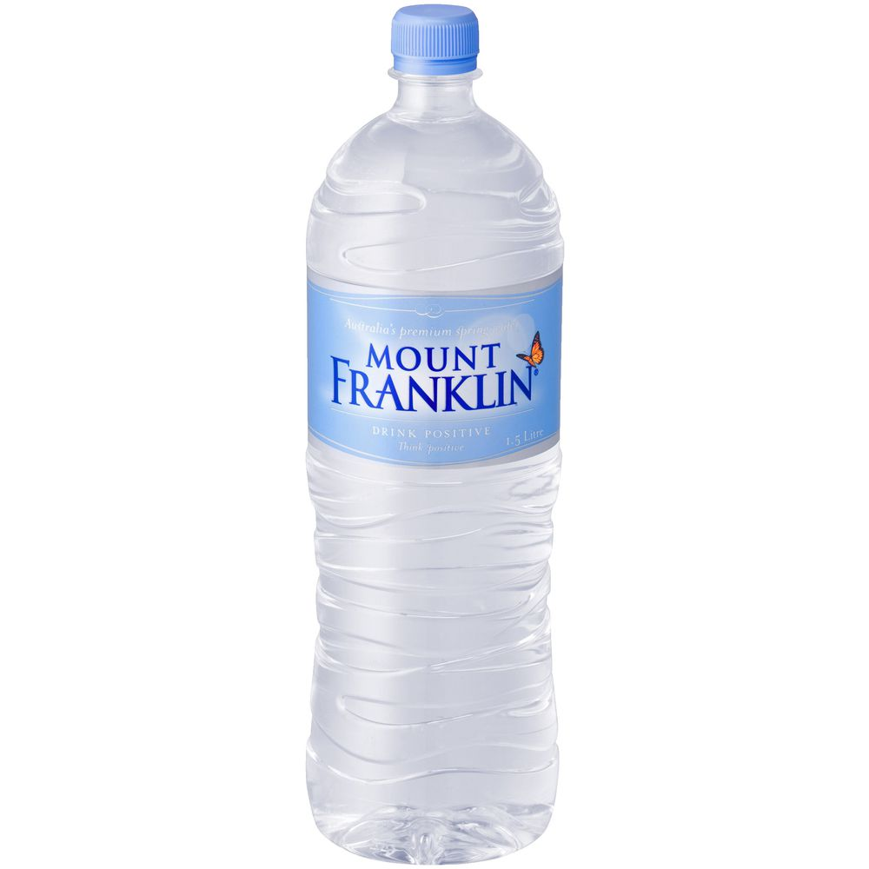
How much we use each day
The current average daily water consumption is 340 litres per person, or 900 litres per household.
That’s 340 bottles of Mt Franklin water!!!

Slide 12
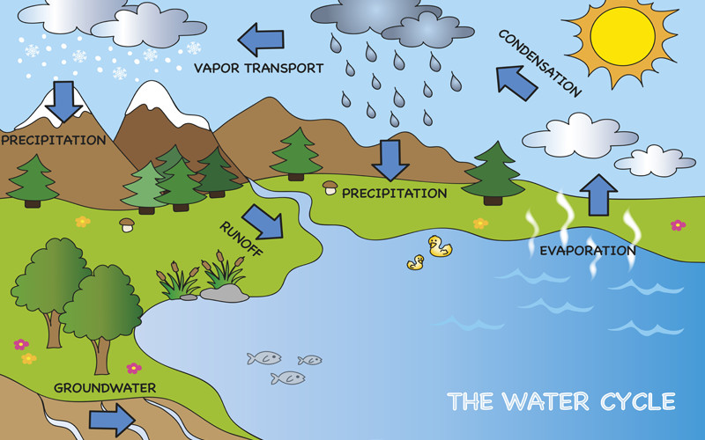
The Water Cycle https://www.youtube.com/watch?v=TWb4KlM2vts
Remember PERTIC!

Slide 13
Precipitation
Wet air is forced higher into the atmosphere. It cools down and droplets join together and become heavier. They then fall as precipitation (rain, snow, hail) onto land, ocean, rivers or lakes

Slide 14
Evaporation
The sun heats the water in oceans, lakes and rivers and turns it into a gas called water vapour. It rises into the air through a process known as evaporation

Slide 15
Run-off
Some of the precipitation that falls on land returns straight to rivers, lakes and oceans as run-off

Slide 16
Transpiration
The process of water moving through a plant then being evaporated from its leaves, flowers and stems.

Slide 17
Infiltration
Water lands on the ground and soaks into the soil. Plants take it in through their roots.

Slide 18
Condensation
Vapour in the air that changes into drops and gathers into clouds. The drops are so small they can float in the air.

